Slide 1
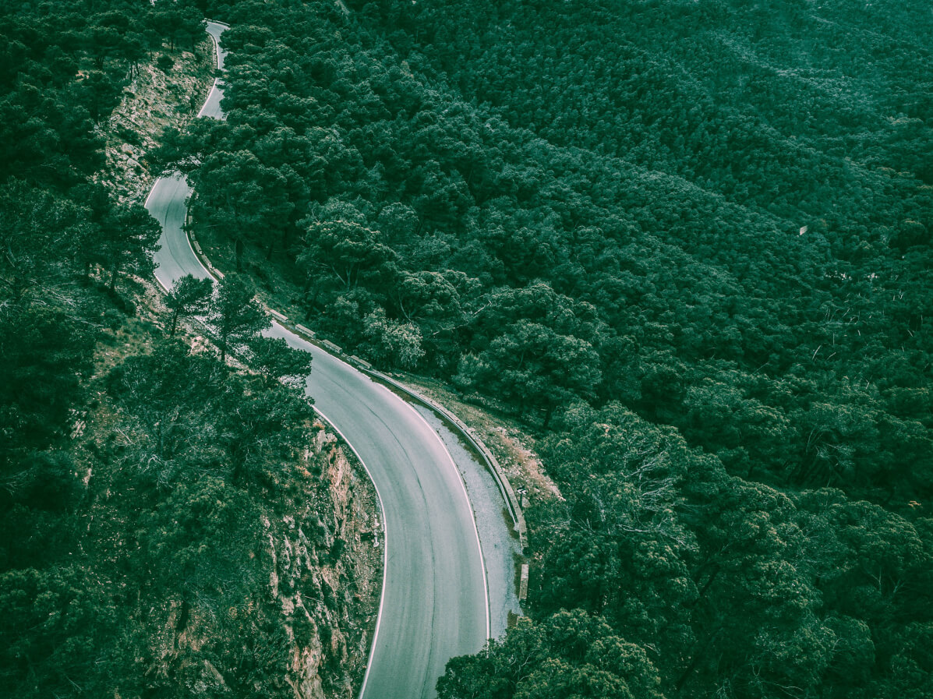
Годовой отчет
ВО «Правильный Выбор»

Slide 2
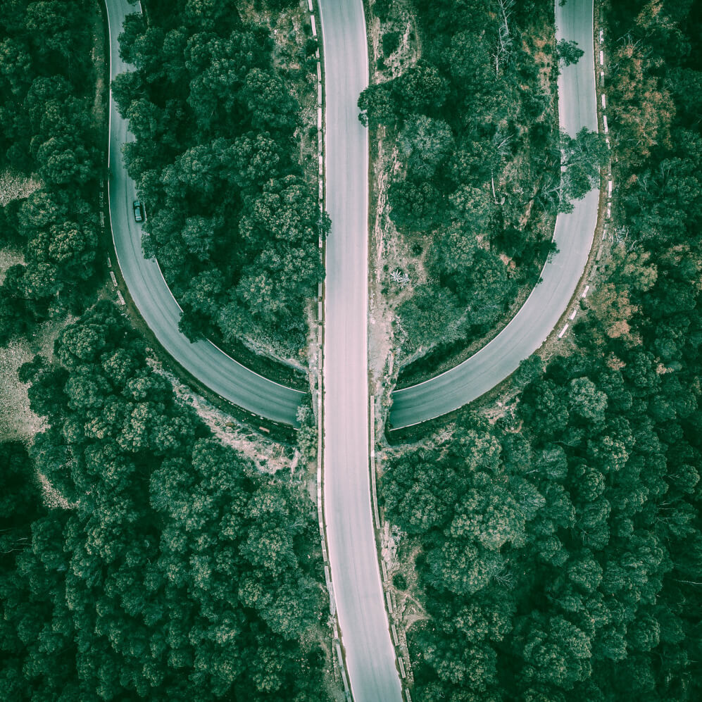
Лекции
Does anyone have any questions?
Follow the project updates
addyouremail@freepik.com
+91 620 421 838
yourcompany.com

Slide 3
OUR LOCATIONS
Учреждения, с которыми мы работали в 2021-2022 году
ГУСО "ЧЦПДОПР им.В.Н.Подгорбунского
Наркоконтроль
Читинский мед. Колледж
Читинский пед. Колледж
Школы:
№42
№6
№21
№19
Гимназия №12
№3 пгт. Дарасун
№17

Slide 4
Медицинская суббота 16.10.2021
Тема лекций: ЗОЖ
Школы: №42, №6, №21.
Классы: 10, 8, 11, 7, 6, 5, 4
Охват участников: 272 человека

Slide 5
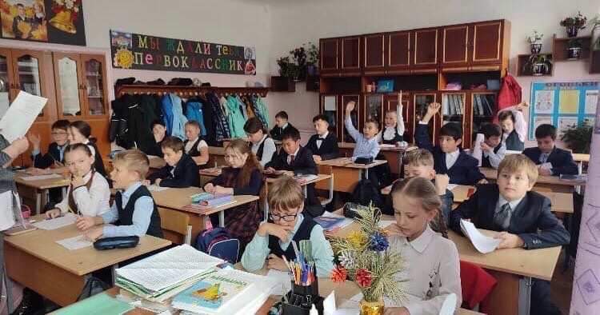
01

Slide 6
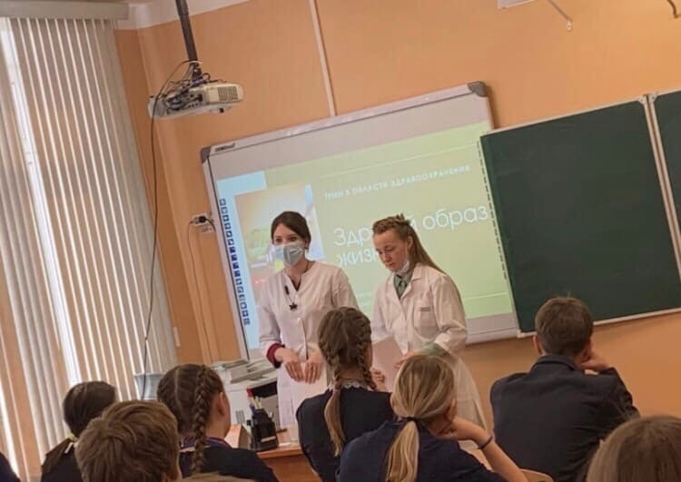
CONTENTS OF THIS TEMPLATE
Here’s what you’ll find in this Slidesgo template:
A slide structure based on a Project Proposal, which you can easily adapt to your needs. For more info on how to edit the template, please visit Slidesgo School or read our FAQs.
An assortment of pictures to use in the presentation can be found in the alternative resources slide.
A credits slide, which you must keep so that proper credits for our design are given.
A resources slide, where you’ll find links to all the elements used in the template.
Instructions for use.
Final slides with:
The fonts and colors used in the template.
More infographic resources, whose size and color can be edited.
Sets of customizable icons of the following themes: general, business, avatar, creative process, education, help & support, medical, nature, performing arts, SEO & marketing, and teamwork.
You can delete this slide when you’re done editing the presentation.

Slide 7
21.10.21
MERCURY
VENUS
Тема лекции: Половое воспитание Школа: №19 Класс: 8 Охват участников: 21
Venus has a beautiful name and is the second planet from the Sun. It’s terribly hot—even hotter than Mercury—and its atmosphere is extremely poisonous. It’s the second-brightest natural object in the night sky

Slide 8
NOW
Mercury is the closest planet to the Sun and the smallest one in our Solar System—it’s only a bit larger than our Moon. The planet’s name has nothing to do with the liquid metal, since it was named after the Roman messenger god

Slide 9
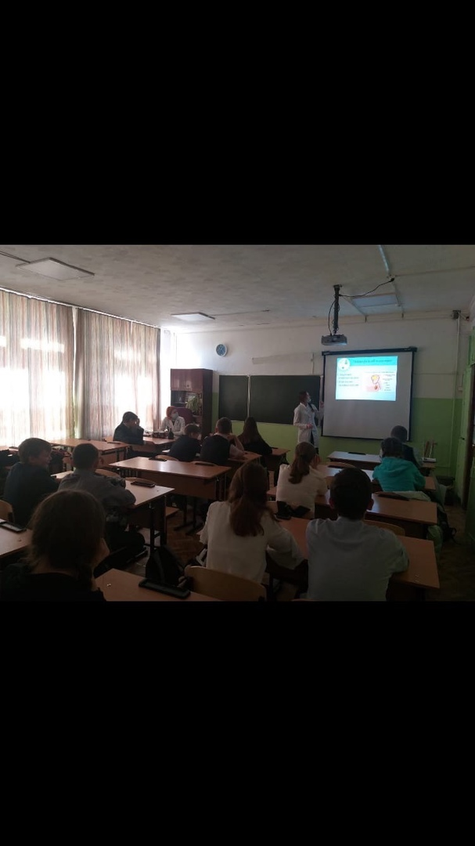
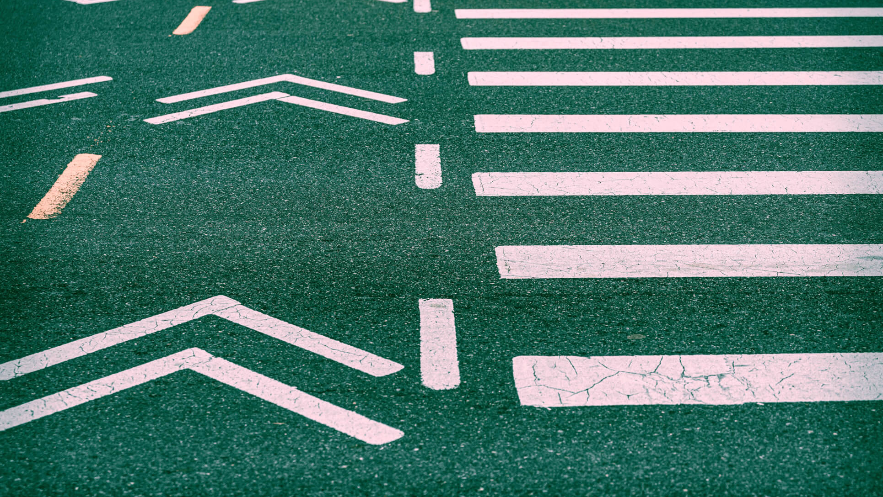
FUTURE
Venus has a beautiful name and is the second planet from the Sun. It’s terribly hot—even hotter than Mercury—and its atmosphere is extremely poisonous. It’s the second-brightest natural object in the night sky after the Moon

Slide 10
01
02
03.03.22
PROJECT GOALS
SNEAK PEEK
03
04
PROJECT STAGES
05
Курс лекций совместно с кафедрой гистологии на темы: «Влияние электронных сигарет на организм» и «Влияние курения на организм подростков. Гимназия №12 Классы: 11а, 11б, 5а, 5б, 5в, 9, 6, 8 Охват участников: 209
Here you could describe the topic of the section
Here you could describe the topic of the section
Here you could describe the topic of the section
Here you could describe the topic of the section
Here you could describe the topic of the section

Slide 11
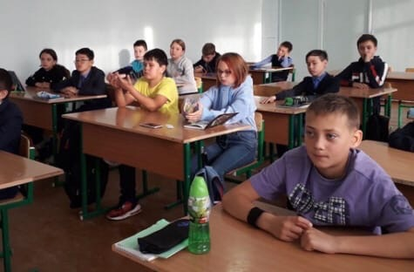
AWESOME WORDS

Slide 12
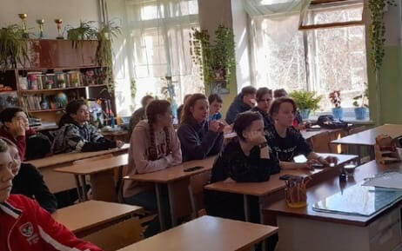
MARS
JUPITER
SATURN
MAJOR REQUIREMENTS
MERCURY
NEPTUNE
VENUS
Despite being red, Mars is a cold place, not hot. It’s full of iron oxide dust
It’s a gas giant, the biggest planet in our Solar System and the fourth-brightest object in the sky
Yes, this is the ringed one. It’s a gas giant, composed of hydrogen and helium
Mercury is actually the smallest planet in our Solar System
Neptune is the fourth-largest planet in our Solar System and the farthest from the Sun
Venus has a beautiful name and is the second planet from the Sun. It’s terribly hot

Slide 13
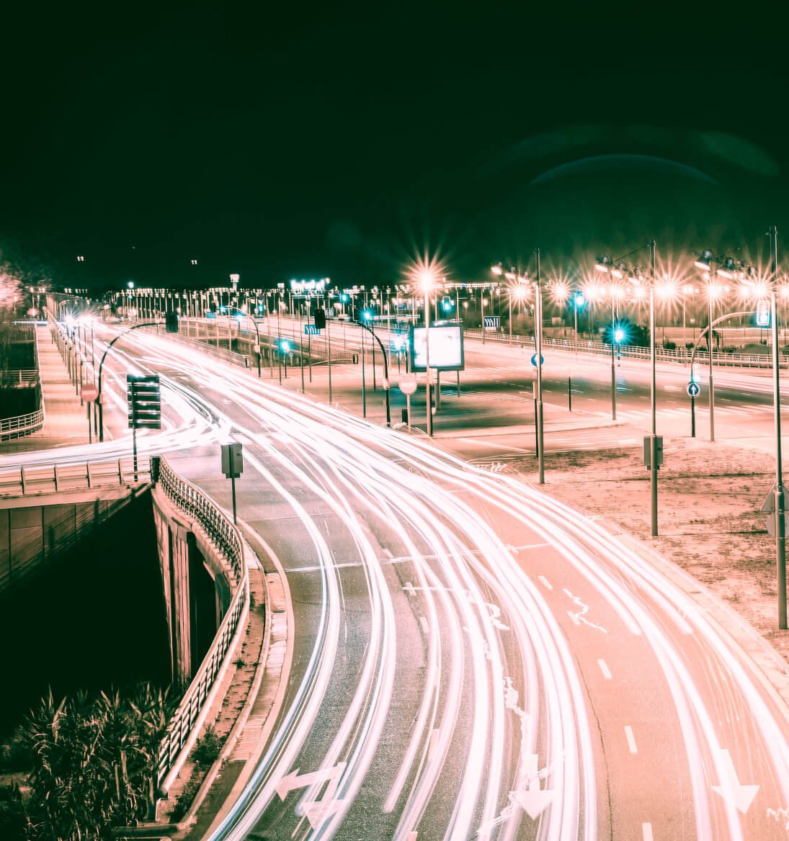
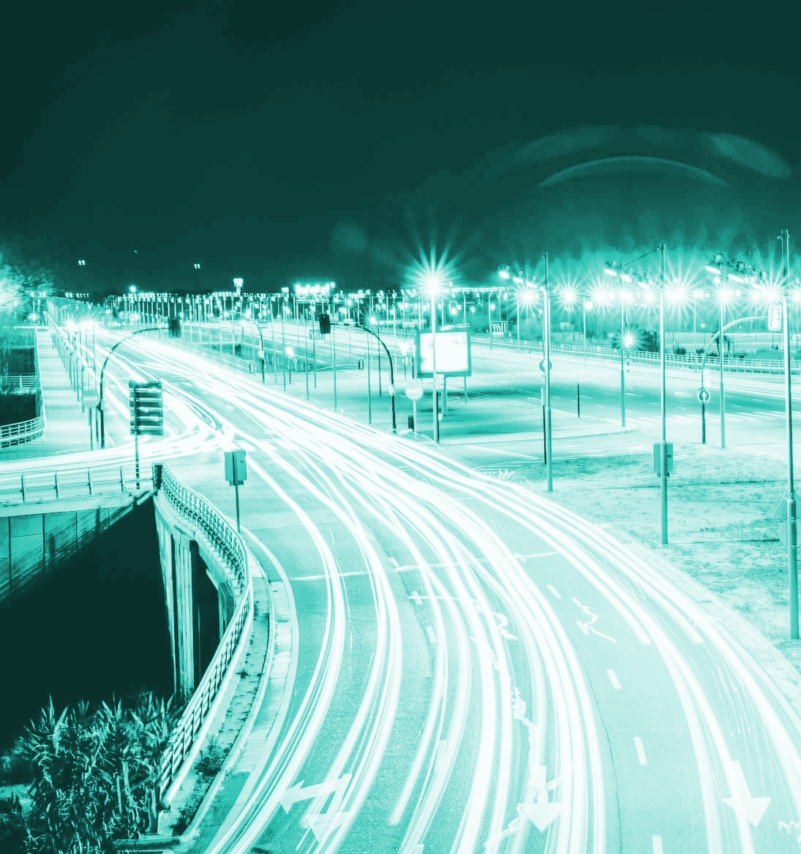
18.03.22 Лекция совместно с кафедрой гистологии на тему: «Влияние электронных сигарет на организм. Читинский пед.колледж Охват участников: 70

Slide 14
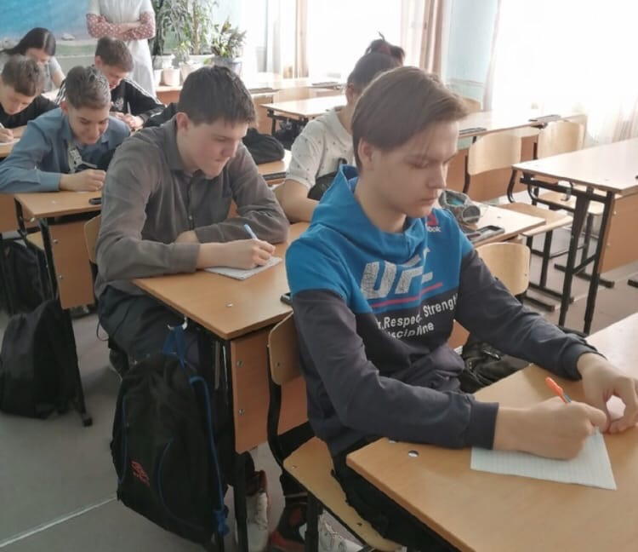
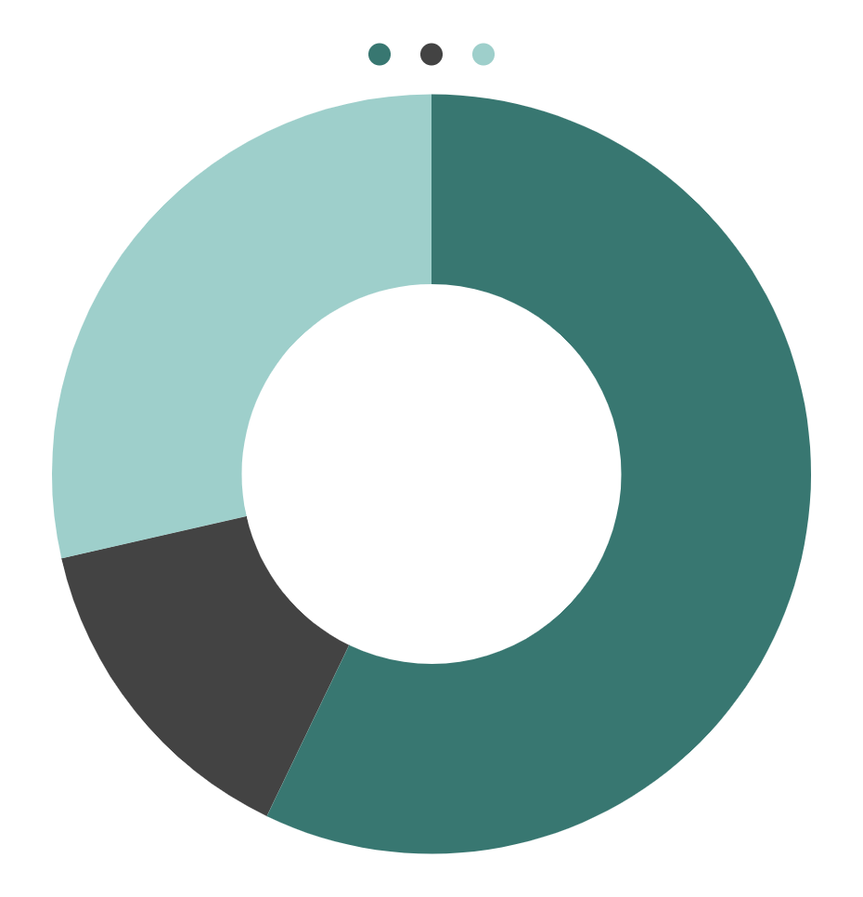
VENUS
30%
BUDGET
MARS
60%
MERCURY
10%
If you want to modify this graph, click on it, follow the link, change the data and replace it

Slide 15
“Here comes the quote. Words full of wisdom that someone important said and can make the reader get inspired.”
Экскурсии

Slide 16
WHAT WE ARE WORKINGN
16.10.2021 Экскурсия по ЧГМА и анатомическому музею Школа: № 3 пгт. Дарасун Классы: 9-11 Охват участников: 14
23.03.22 Экскурсия в анатомический музей Школа: № 17 Класс: 9 Охват участников: 13
17.10.2021 Экскурсия по ЧГМА для учеников 9-ых классов 9 классы школ города Читы Охват участников: 21
24.03.22 Экскурсия по ЧГМА и анатомическому музею ГУСО "ЧЦПДОПР им.В.Н.Подгорбунского Охват участников: 7
Despite being red, Mars is a cold place, not hot. It’s full of iron oxide dust, which gives the planet its reddish cast
Jupiter is a gas giant and the biggest planet in our Solar System. It’s the fourth-brightest object in the sky
Yes, Saturn is the ringed one. This planet is a gas giant, and it’s composed mostly of hydrogen and helium
Venus has a beautiful name and is the second planet from the Sun. It’s terribly hot, even hotter than Mercury

Slide 17
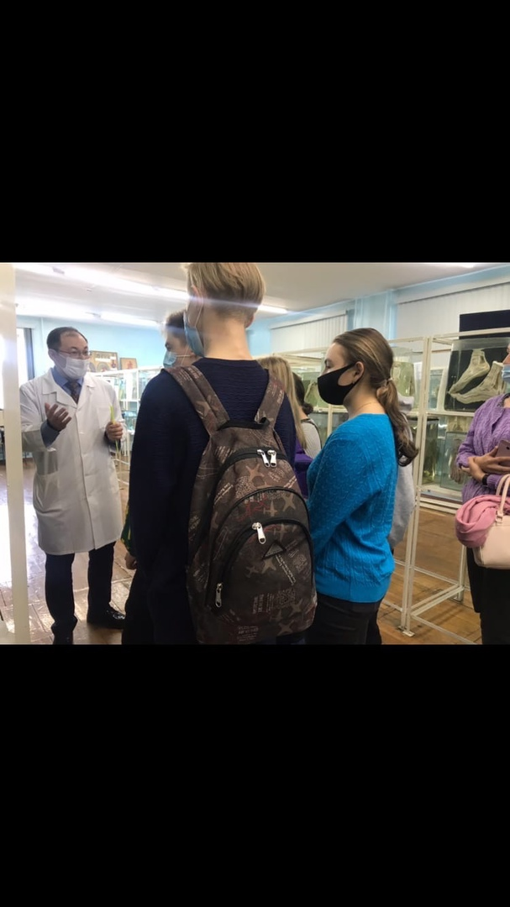
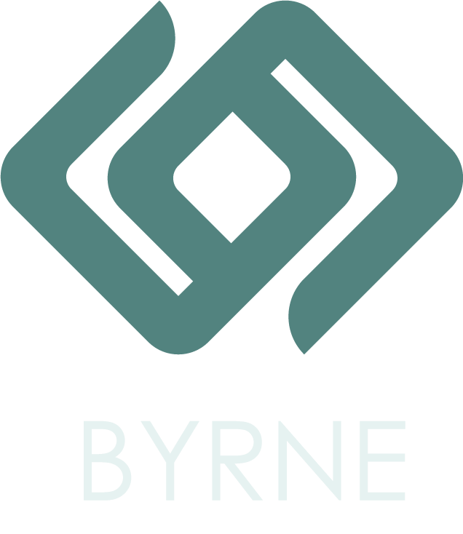
OUR COMPANY
Mercury is the closest planet to the Sun and the smallest one in the Solar System—it’s only a bit larger than our Moon. The planet’s name has nothing to do with the liquid metal since it was named after the Roman messenger god, Mercury

Slide 18
PROJECT GOALS
GOAL 2
19.04.2022 Экскурсия по анатомическому музею и академ.городку ЧГМА Читинский медицинский колледж Охват участников: 50 21.04.2022 Экскурсия по анатомическому музею и академ.городку ЧГМА Совместно с наркоконтролем Охват участников: 60
Mercury is the closest planet to the Sun and the smallest one in the Solar System—it’s only a bit larger than our Moon
Venus has a beautiful name and is the second planet from the Sun. It’s terribly hot, even hotter than Mercury

Slide 19
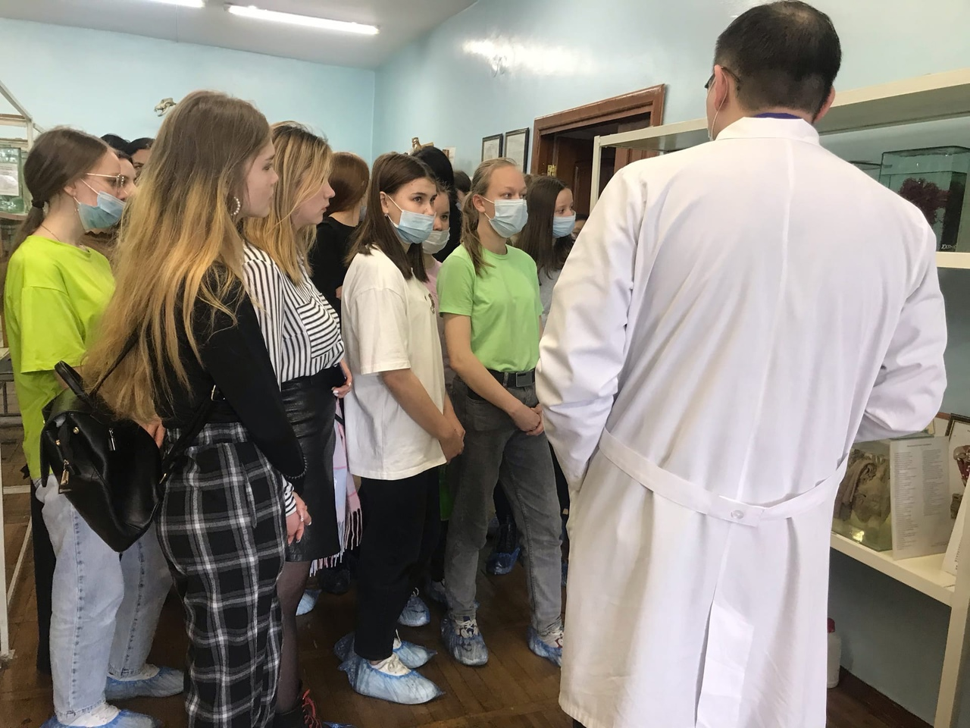
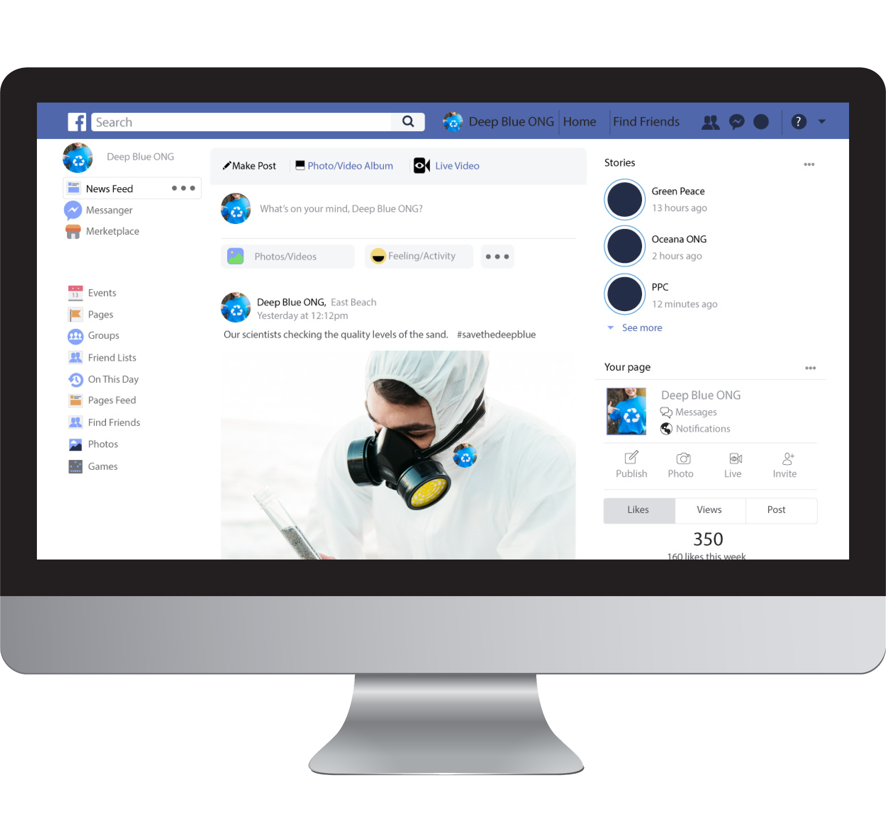
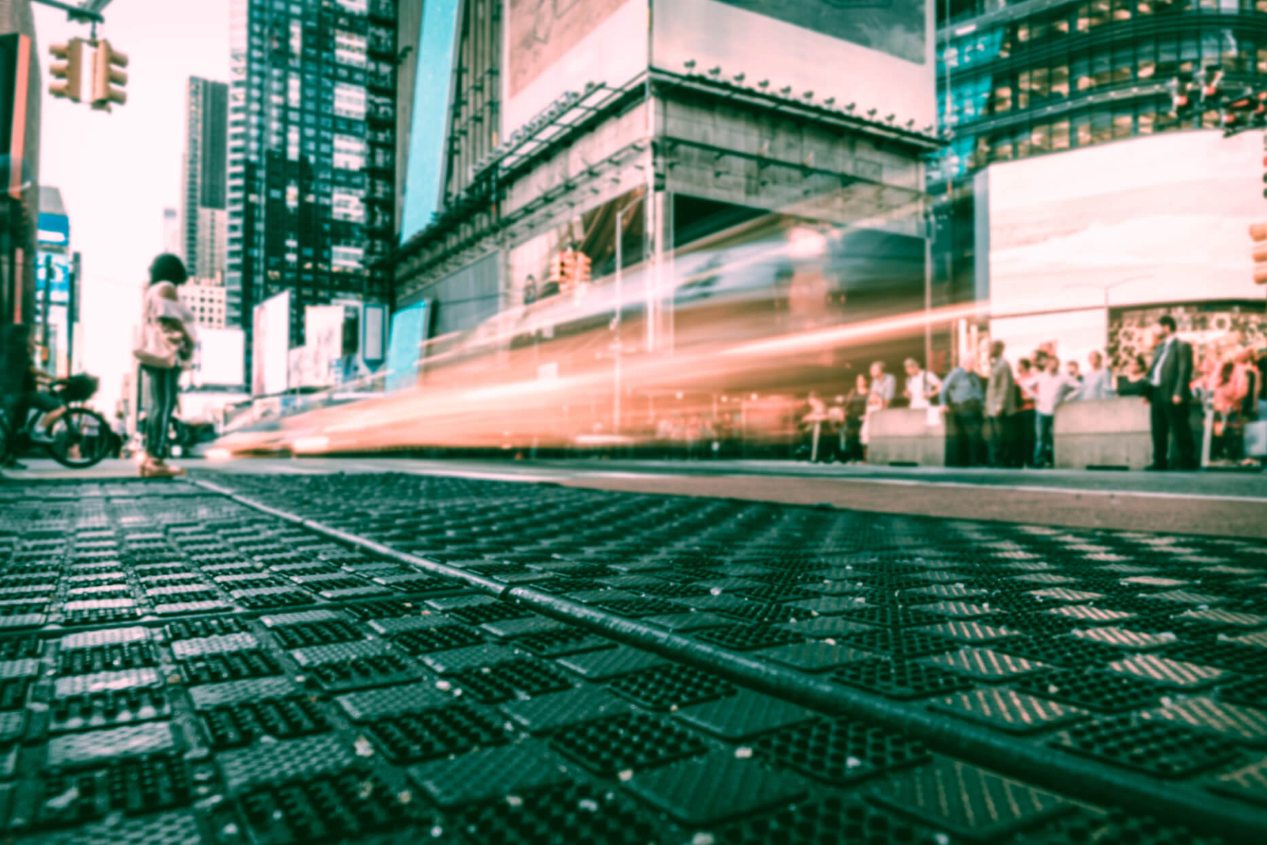
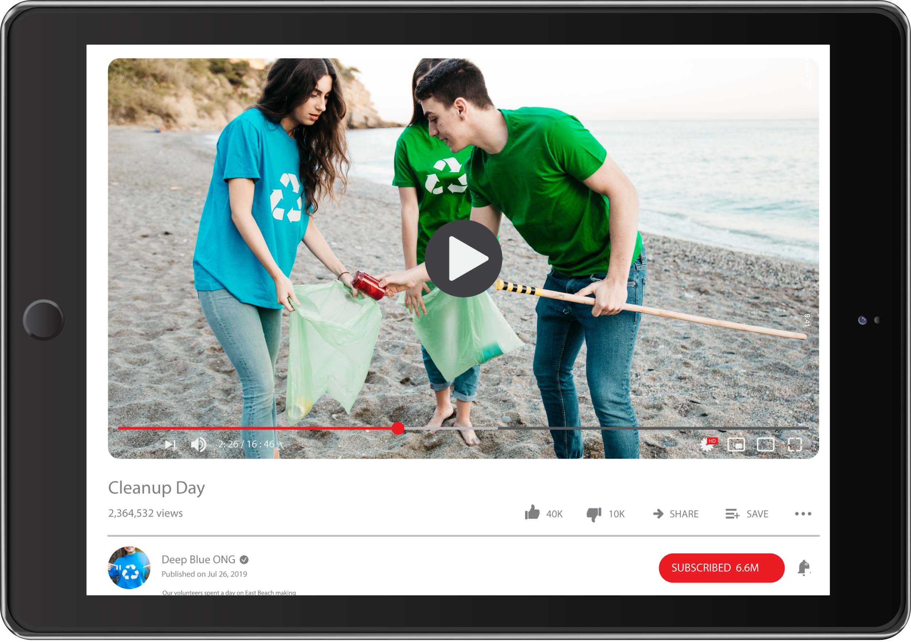
SNEAK PEEK
Insert your multimedia content here

Slide 20
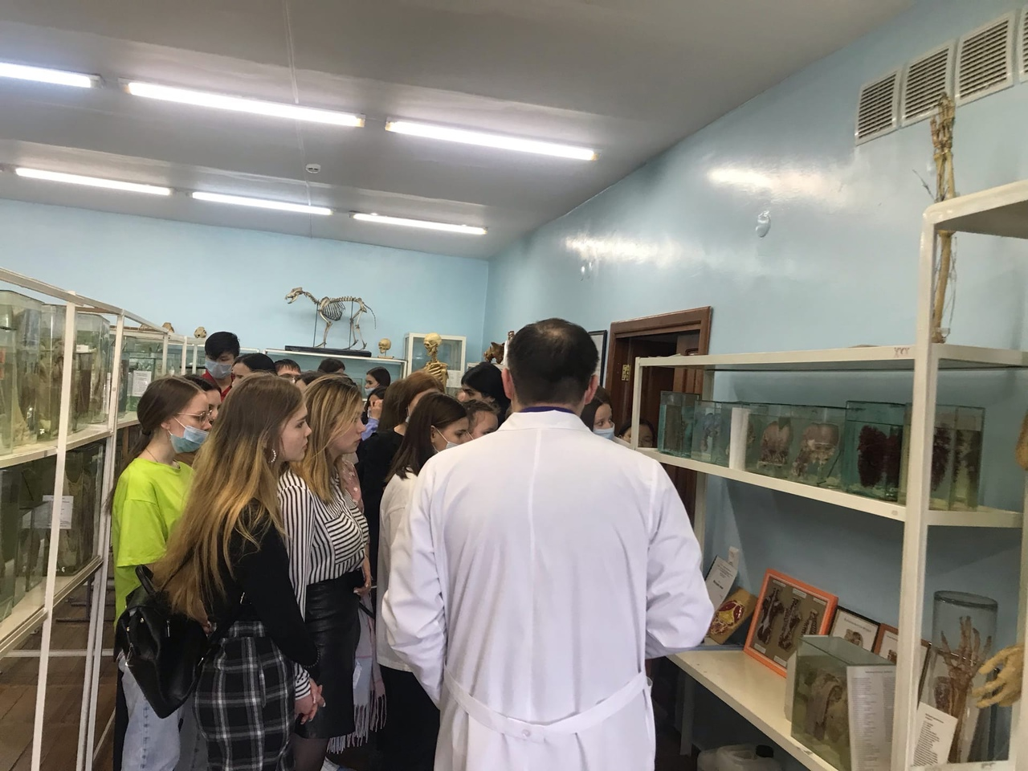
STAGE 1
PROJECT STAGES
STAGE 2
STAGE 3
Venus has a beautiful name and is the second planet from the Sun. It’s terribly hot
Mercury is the closest planet to the Sun and the smallest one in the Solar System
Despite being red, Mars is a cold place, not hot. It’s full of iron oxide dust, giving the planet its reddish cast

Slide 21
OUR TEAM
Флешмоб "#СвоихНеБросаем" , который был запущен МЦ "Искра" в поддержку российских военнослужащих
You can replace the image on the screen with your own

Slide 22
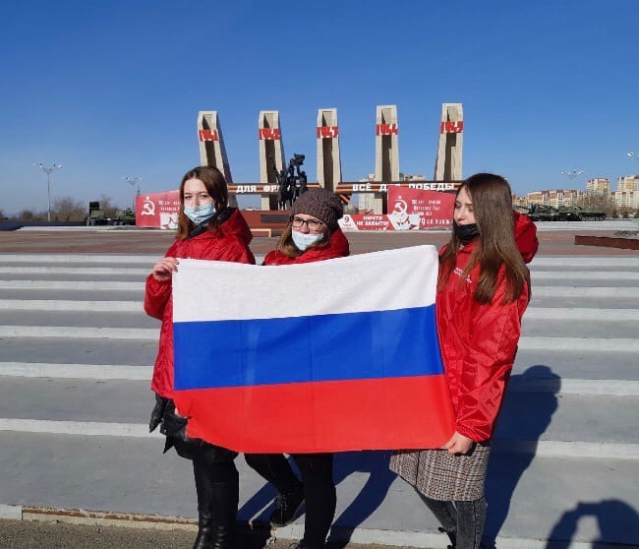
MERCURY
MARS
FUTURE PROJECTS
VENUS
SATURN
Mercury is the closest planet to the Sun and the smallest one in the Solar System
Despite being red, Mars is a cold place, not hot. It’s full of iron oxide dust
Venus has a beautiful name and is the second planet from the Sun
Saturn is the ringed planet. It’s a gas giant, composed mostly of hydrogen and helium

Slide 23
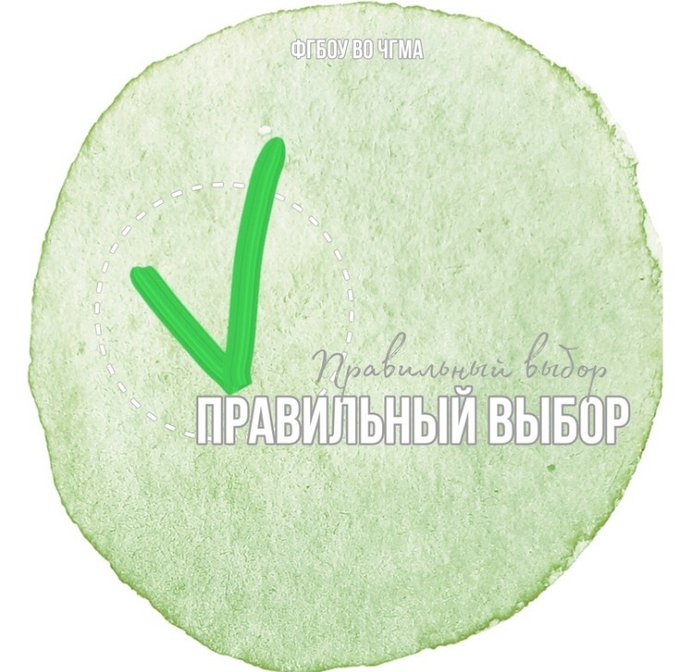
Спасибо за внимание!
С любовью
ВО «Правильный Выбор»

